Slide 1
Basic Concept of
GSM Cellular Communications
Miftadi Sudjai, Ir., MSc., MPhil.
miftadi@yahoo.com
PT. StreamCom
Bandung

Slide 2
A Little Piece of History
1983
1991
1998
200x
1G
2G
2.5G
3G
IMT-2000/
UMTS
AMPS, TACS, NMT, etc
GPRS & EDGE
GSM
Analog
speech
Digial speech,
low speed data
Digial speech,
low speed data,
medium speed
up to 384 kbs
4 QoS Class :
Conversational, streaming, interactive, & background

Slide 3
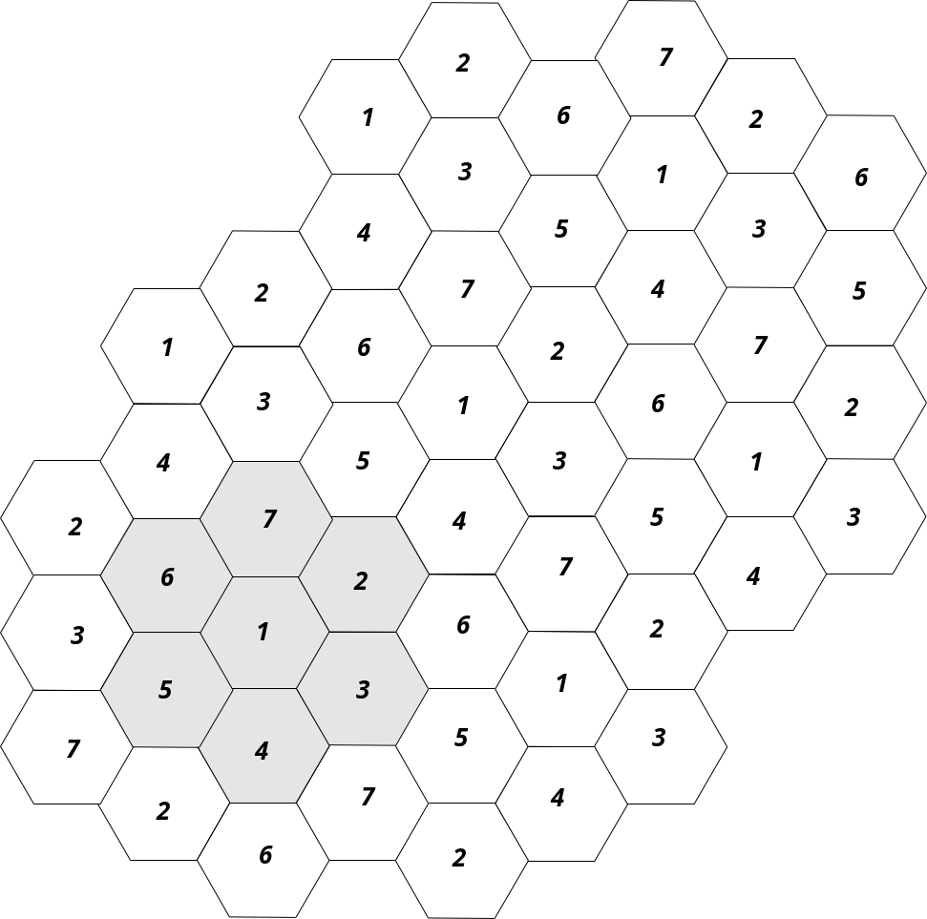
Cellular Communication System
It provide wireless connection from users to PSTN or between its users.
Use “cells” in order to increase the total capacity, given a limited spectrum, by re-using the frequency over different areas.
Use a Handover mechanism to enable an uninterrupted call connection when users move from one cell to another.

Slide 4
What makes Cellular Radio work?
Allows frequency reuse
Requires handover from one cell to the next
Attenuation of the propagating radio waves like d^{-n}, n > 2
High Quality services comparable to PSTN.
Other important considerations
  Multipath/fading
  Other-user interference
  Spectral efficiency
  Quality of service

Slide 5
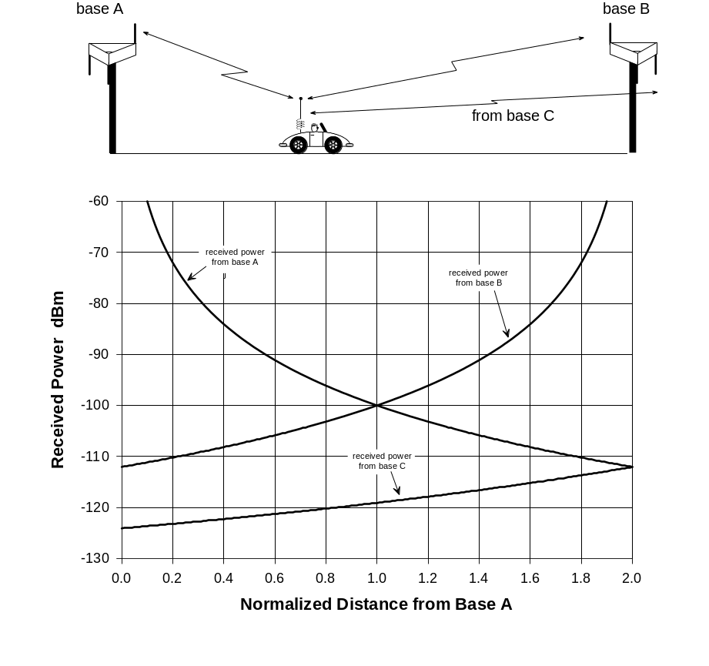
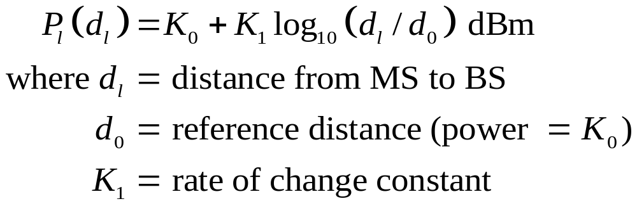
Power Received at Mobile from Two Base Stations
Power received at mobile
from station l:
If stations A and B are using the
same channel,the signal power from B is cochannel interference:

Slide 6
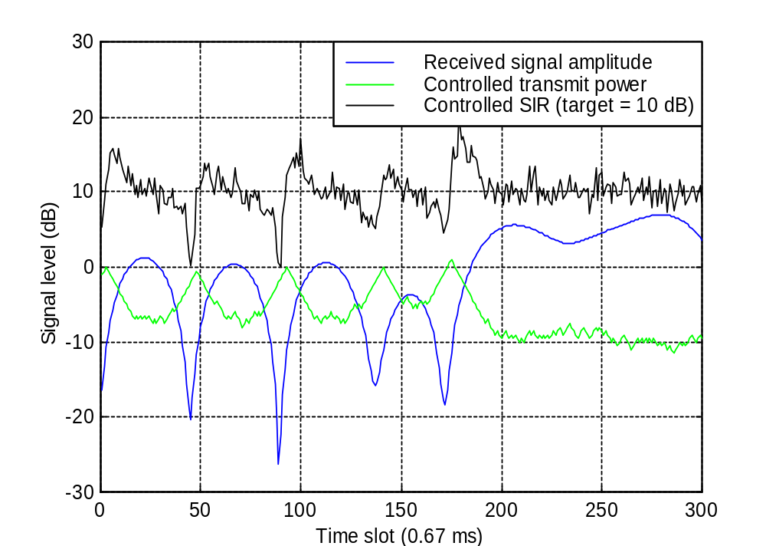
Radio Propagation has major impact …
Target SIR
RSL
TX power

Slide 7
Handover Mechanism
Level at B
RSL
Level which HO occured
time
BS1
BS2
A
B

Slide 8
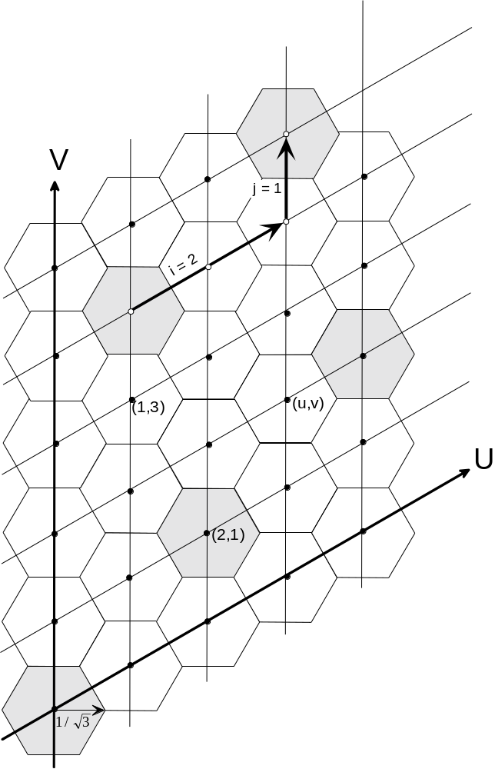
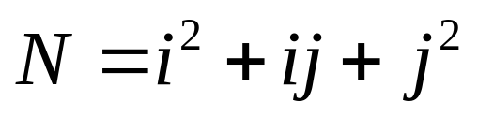
Hexagonal Cell Geometry
Define coordinate axes,
U & V, at 60º angles
For given frequency
reuse plan, go i steps
in U direction and j
steps in V direction
Number of cells in
reuse pattern is
N = 7 reuse pattern

Slide 9
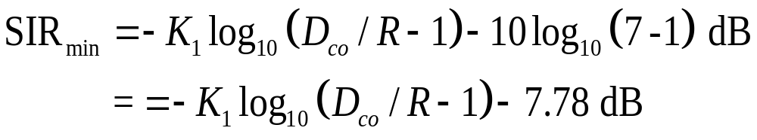
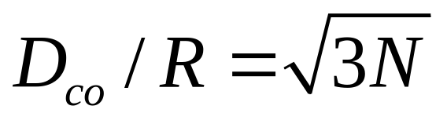
Frequency Re-use Plan
Consider closest ring
of interfering BSs:
No. of cells in reuse plan:
It shows that
D_{co}
R

Slide 10
Interference and Capacity
1st tier of co-ch cell, N=7
D+R
D-R/2
D+R/2
R
MS
D-R
D
D-R

Slide 11
Interference and Capacity
Co-ch reuse ratio, Q = (D/R)^{0.5} = (3N)^{0.5}
B spectrum is divided into k ch per Sel, then each cluster has k.N channel. If N cluster is repeated M times to cover the whole area/coverage, so the total capacity is: C = M.k.N
 | Cluster size (N) | Q
i=1, j=1 | 3 | 3
i=1, j=2 | 7 | 4.58
i=2, j=2, etc | 12 | 6

Slide 12
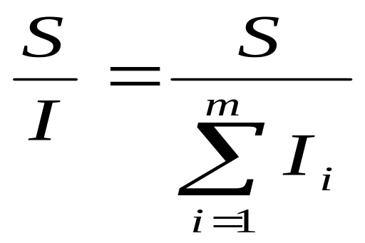
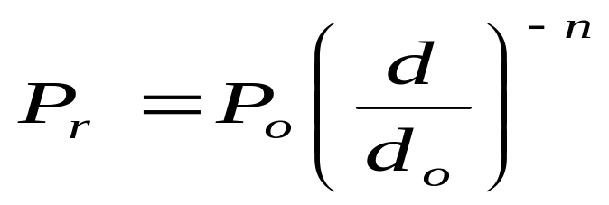
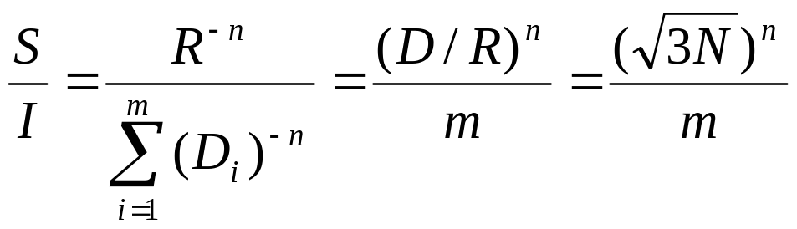
Interference
SIR of a MS:
where m = number of interfering cells in 1st tier
Propagation law (path loss exponent):
n = 2 ..5
If the interfering BS are equidistant:

Slide 13
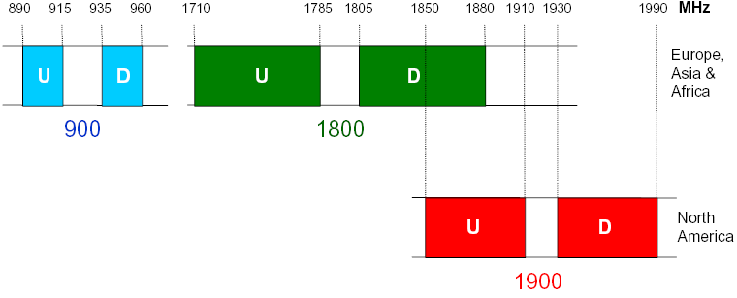
The GSM
Spectrum variant with 200 kHz ch Bandwidth:
GSM900 at 900 MHz
  124 carriers @ 2x25 MHz band
GSM1800 at 1800 MHz (DCS1800)
  375 carriers @ 2x75 MHz band
GSM1900 at 1900 MHz (PCS1900)
  300 carriers @ 2x60 MHz band

Slide 14
GSM Architecture
Mobile Stations
(MS)
Base Transceiver
A interface
Station (BTS)
Base Station
VLR
Controller (BSC)
HLR
Base Transceiver
Abis interface
Station (BTS)
Base Station (BS)
GMSC
PSTN
Mobile
Um interface
Switching
Centre
(MSC)
Base Transceiver
Station (BTS)
Base Station
CCITT
Controller (BSC)
Signalling
Base Transceiver
Abis interface
System No. 7
Station (BTS)
Base Station (BS)
(SS7)
interface

Slide 15
Elements of the Network
Subscriber: user who pays subscription charges for using mobile communication services.
Mobile Station: is a subscriber unit intended for use while on the move at unspecified locations. It could be a hand-held or a portable terminal.
Base Station: a fixed radio station used for communication with MS. It is located at the centre of a cell and consist of Transmitters and Receivers.
Mobile Switching Centre : it coordinates the routing of calls, do the billing, etc.

Slide 16
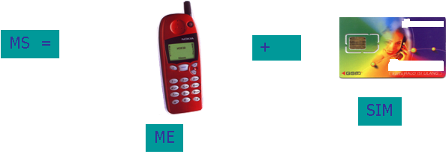
Mobile Station
MS consist of :
  Mobile Equipment (ME)
  Subscriber Identification Module (SIM)

Slide 17
SIM Card
Subscriber Identity Module (SIM) is a smart card which stores information about the subscription and feature of services.
Stored information including:
  Authentication Key “Ki”
  Encryption
  IMSI and TMSI
SIM card is protected by a Personal Identity Number (PIN) of the user

Slide 18
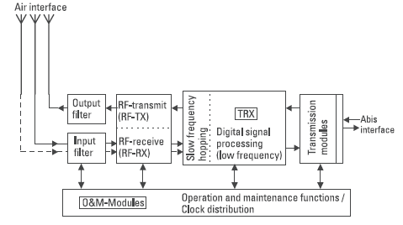
Base Transceiver Station (BTS)
BSS consist of two part :
  Base Transceiver Station (BTS)
  Base Station Controller (BSC)
BTS is a radio-end which determine a cell coverage and provide link with MS.
BTS include Transmitters and Receivers, antenna and signal processing unit as well as interface.
BTS communicate with MS via Um (air) interface

Slide 19
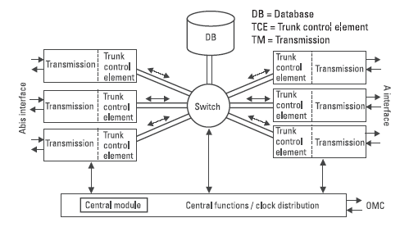
Base Station Controller
BSC control RRM for BTSs.
BSC handle radio-channel setup, frequency hopping, and handover within BSC

Slide 20
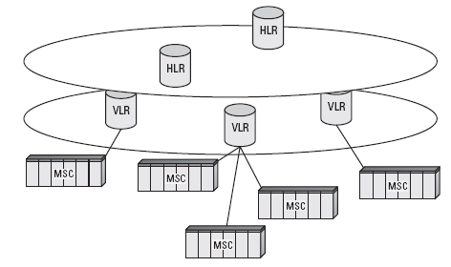
Mobile Switching Center (MSC)
As a central switch for routing the traffic
Control BSC via A-interface
As a interconnection between GSM network with other Networks via Internetworking Function (IWF)

Slide 21
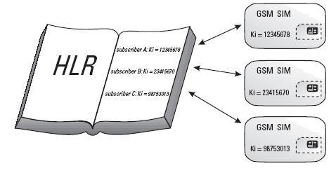
Home Location Register (HLR)
HLR contain database of users, including all the subscription records
HLR records the update location of every user for mobility management purposes

Slide 22
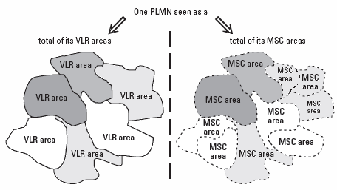
Visitor Location Register (VLR)
VLR is a temporary database of user
VLR is used to handle a roamer connection.
VLR could be accessed by MSC for every call set up.
Every MSC is connected to a VLR, but a VLR could be connected to several MSC

Slide 23
3G UMTS W-CDMA

Slide 24
UMTS W-CDMA Services
High bit rates theoretically up to 2 Mbps in 3GPP Release ’99, and beyond 10 Mbps in 3GPP Release 5. Practical bit rates are up to 384 kbps initially, and beyond 2 Mbps with Release 5;
Low delays with packet round trip times below 200 ms;
Seamless mobility also for packet data applications;
Quality of Service differentiation for high efficiency of service delivery;
Simultaneous voice and data capability;
Interworking with existing GSM/GPRS networks.

Slide 25
Class of Services
4 QoS Classes :
1. Conversational Service
2. Streaming
3. Interactive
4. Background
The main distinguishing factor is flow delay sensitive of the traffic.
Conversational class is very delay sensitive, while background class is the most delay insensitive.

Slide 26
Characteristics of the Services
Conversational :
  e.g. Telephony/speech, VoIP, Video conferencing
  Communication is real time between peers
  Human perception of audio and video conversation determine max. tolerable delay
  Low delay
Streaming :
  Real time data flow to human/live destination
  Delay is limited
  Preserve time relation between info. Entities of the stream

Slide 27
Characteristics of the Services
Interactive :
  e.g. web browsing, data retrieval, server access, LBS.
  Request response pattern
  Preserve payload content
  More tolerant to delay
Background :
  e.g. Background delivery of e-mail, SMS, download, data base, etc.
  The destination not expecting data within certain time
  Preserve payload content, and not sensitive to delay

Slide 28
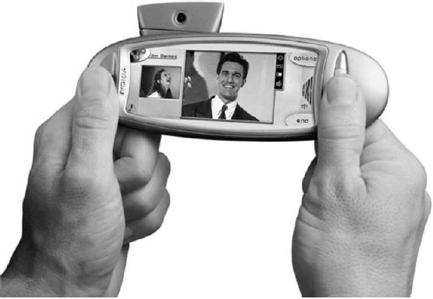
UMTS W-CDMA Application
Multimedia Communication

Slide 29
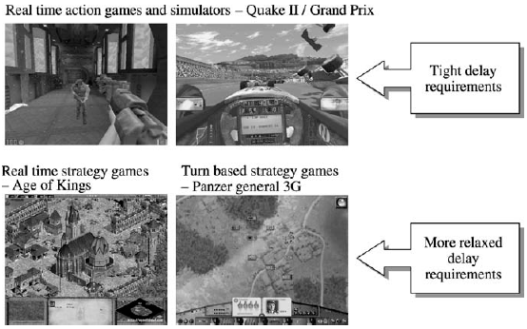
Multiplayer Games

Slide 30
UMTS Basic Parameter
Frequency Bands (FDD : 2x60 MHz):
  1920 to 1980 MHz (Uplink)
  2110 to 2170 MHz (Downlink)
Frequency Bands (TDD: 20 + 15 MHz):
  1900 – 1920 MHz and 2010 – 2025 MHz
RF Carrier Spacing:
  4.4 - 5 MHz
RF Channel Raster:
  200 KHz
Power Control Rate:
  1500 Cycles per Second

Slide 31
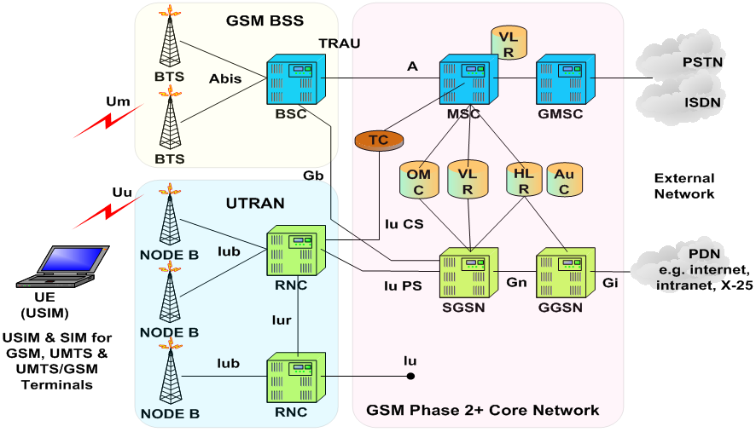
UMTS W-CDMA Architecture

Slide 32
Thank You

